Slide 1


Sybex CCNA 640-802
Chapter 10: Layer-2 Switching and STP
Instructor & Todd Lammle

Slide 2

Chapter 10 Objectives
The CCNA Topics Covered in this chapter include:
What is layer-2 switching
Switching services
Bridges vs. LAN switching
Three switch functions
MAC table
Switching loops Spanning-Tree Protocol (STP)
Configuring Catalyst Switches

Slide 3
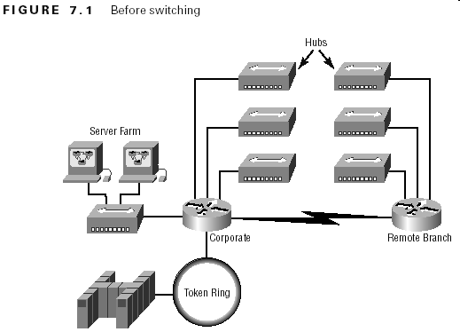
Before Layer 2 Switching

Slide 4
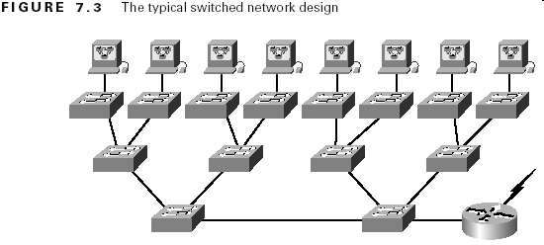
Typical Switched Designs

Slide 5
Switching Services
Layer 2 switching provides:
  Hardware-based bridging (ASIC)
  Wire speed
  Low latency
  Low cost

Slide 6
Layer 2 Switching
Purposes for using switching
  Breaks up collision domains
  Cost-effective, resilient internetwork
Purpose for Spanning-Tree Protocol (STP)
  Stops loops in layer 2 switched networks

Slide 7
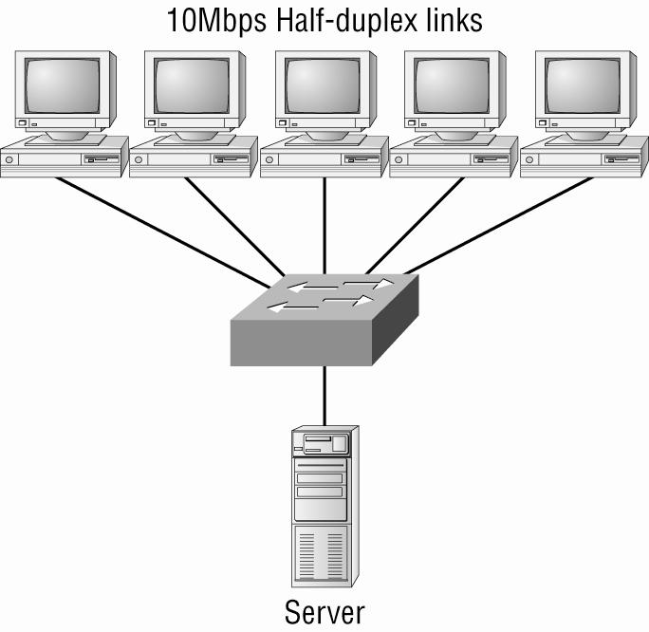
One link to the server!

Slide 8
Limitations of Layer 2 Switching
Must break up the collision domains correctly.
Make sure that users spend 80 percent of their time on the local segment.
Switches do not break up broadcast domains by default.

Slide 9
Bridging vs. LAN switching
Bridges are software based, while switches are hardware based because they use ASIC chips to help make filtering decisions.
A switch can be viewed as a multiport bridge.
There can be only one spanning-tree instance per bridge, while switches can have many.
Most switches have a higher number of ports than most bridges.
Both bridges and switches flood layer 2 broadcasts.
Bridges and switches learn MAC addresses by examining the source address of each frame received.
Both bridges and switches make forwarding decisions based on layer 2 addresses

Slide 10
Three Switch Functions at Layer-2
Address learning Layer 2 switches and bridges remember the source hardware address of each frame received on an interface, and they enter this information into a MAC database called a forward/filter table.
Forward/filter decisions When a frame is received on an interface, the switch looks at the destination hardware address and finds the exit interface in the MAC database. The frame is only forwarded out an appropriate destination port.
Loop avoidance If multiple connections between switches are created for redundancy purposes, network loops can occur. Spanning Tree Protocol (STP) is used to stop network loops while still permitting redundancy.

Slide 11
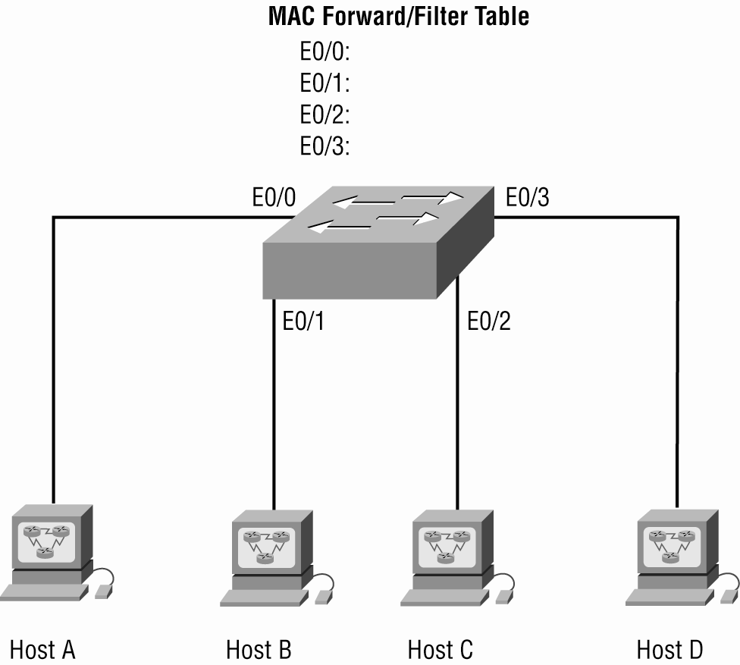
Empty MAC table

Slide 12
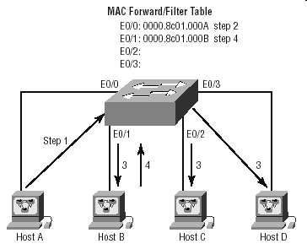
How Switches Learn Hosts’ Locations

Slide 13
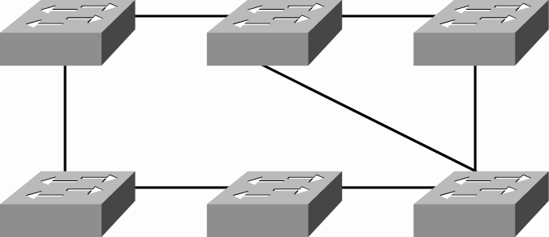
Switching Loops

Slide 14
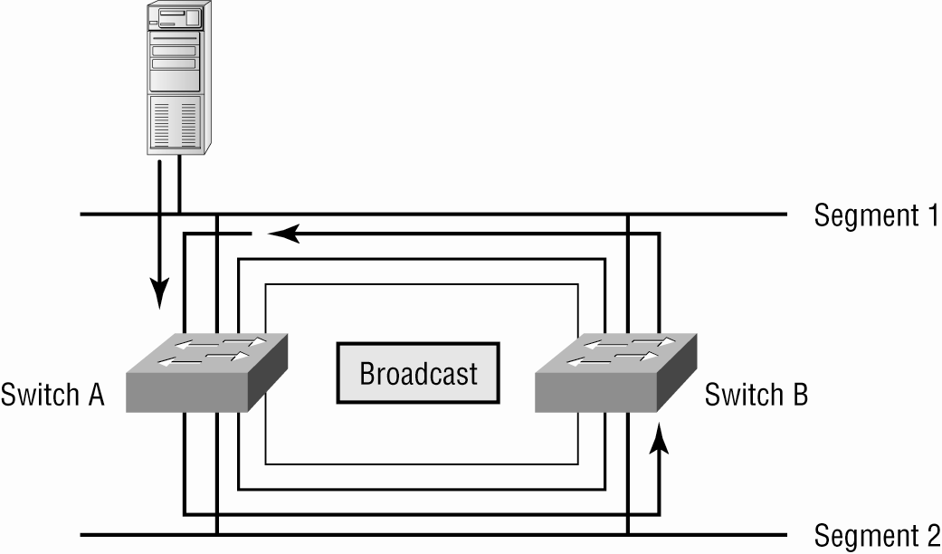
Switching Loops

Slide 15
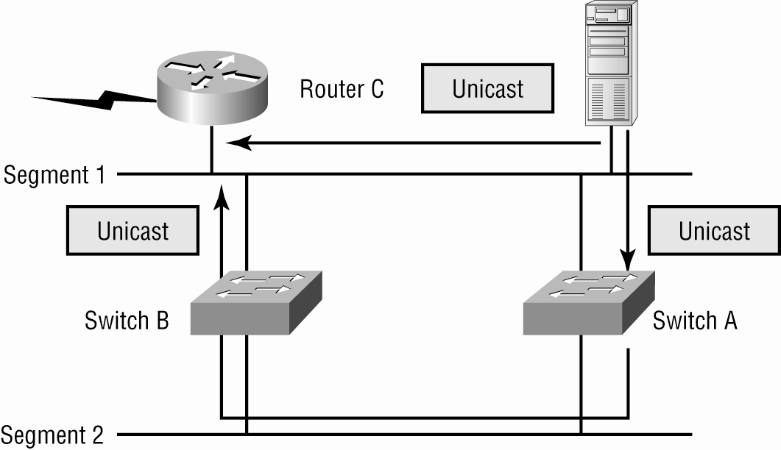
Switching Loop Problems

Slide 16
STP
Terminology
Root Bridge
BPDU
Bridge ID
Nonroot Bridge
Root port
Designated port
Port cost
Nondesignated port
Forwarding port
Block port

Slide 17
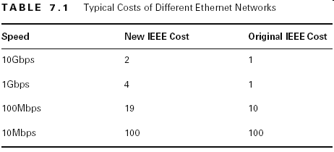
Spanning-Tree Operations
Selecting the root bridge
Selecting the designated port

Slide 18
Spanning-Tree Port States
Blocking
Listening
Forwarding
Disabled

Slide 19
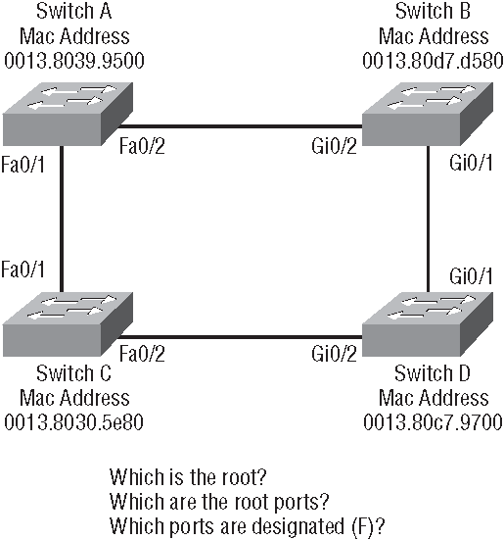
Spanning-Tree Example

Slide 20
Configuring Catalyst Switches
Administrative functions
Configuring the IP address and subnet mask
Setting the IP default gateway
Setting port security
Setting PortFast
Enabling BPDUGuard and BPDUFilter
Enabling UplinkFast
Enabling BackboneFast
Enabling RSTP (802.1w)
Enabling EtherChannel
Configuring an STP root switch

Slide 21
Administrative functions
Switch>en
Switch#config t
Enter configuration commands, one per line. End with CNTL/Z.
Switch(config)#hostname S1
S1(config)#enable secret todd
S1(config)#int f0/1
S1(config-if)#description 1st Connection to Core Switch
S1(config-if)#line console 0
S1(config-line)#password console
S1(config-line)#login
S1(config-line)#exit
S1(config)#line vty 0 15
S1(config-line)#password telnet
S1(config-line)#login

Slide 22
IP address and subnet mask
S1(config-line)#int vlan 1
S1(config-if)#ip address 192.168.10.17 255.255.255.240
S1(config-if)#no shut
S1(config-if)#exit
S1(config)#banner motd # This is the S1 switch #
S1(config)#exit
S1#copy run start
Destination filename [startup-config]? [enter]

Slide 23
Port security
S1(config)#int range fa0/3 - 4
S1(config-if-range)#switchport mode access
S1(config-if-range)#switchport port-security
S1(config-if-range)#switchport port-security maximum 1
S1(config-if-range)#switchport port-security mac-address sticky
S1(config-if-range)#switchport port-security violation shutdown

Slide 24
Port Settings
Portfast
S1(config-if-range)#spanning-tree portfast
BPDUGuard
S1(config-if-range)#spanning-tree bpduguard enable
BPDUFilter
S1(config-if-range)#spanning-tree bpdufilter enable
UplinkFast
S1#config t
S1(config)#spanning-tree uplinkfast
BackboneFast
S1(config)#spanning-tree backbonefast

Slide 25
RSTP and Etherchannel
Enabling RSTP (802.1w)
Core(config)#spanning-tree mode rapid-pvst
EtherChannel
S1#config t
S1(config)#int port-channel 1
S1(config-if)#int range f0/1-2
S1(config-if-range)#switchport mode trunk
S1(config-if-range)#switchport nonegotiate
S1(config-if-range)#channel-group 1 mode desirable

Slide 26
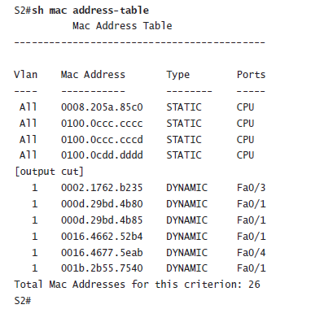
Verifying Cisco Catalyst Switches

Slide 27
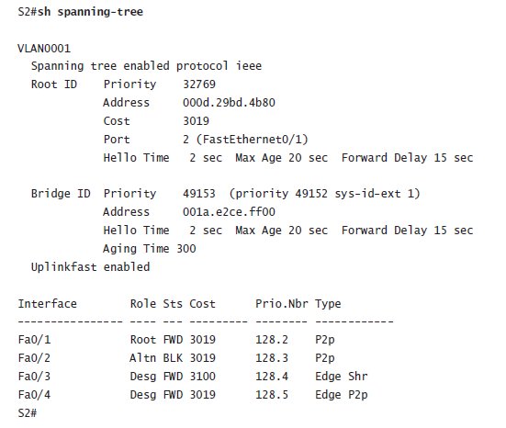
Verifying Cisco Catalyst Switches

Slide 28
Written Labs and Review Questions
  Open your books and go through all the written labs and the review questions.
  Review the answers in class.

